Slide 1

EduHome
by Neha & Abhinav

Slide 2
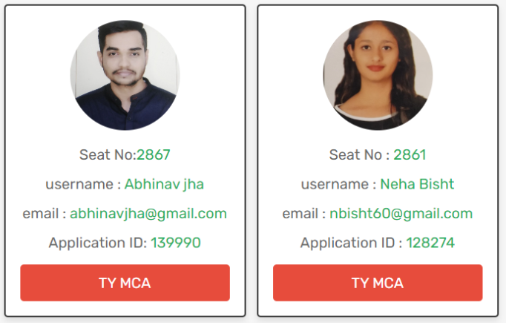
Team Members:
Neha Bisht, Seat No 2861, Application ID: 128274
Abhinav Jha, Seat No 2867, Application ID: 139990
UNDER THE GUIDANCE OF​ Professor – Shajil Kumar Sir​
Vidyalankar Institute of Technology (VIT)​
University of Mumbai(IDOL)​
Master of Computer Application​
2021-2022​

Slide 3
Introduction
The online classroom is a very popular platform for the education system. Many countries are now enforcing the online classroom system so that the teachers and students can communicate with each other. For example, a very common and known to all ‘Google Classroom’. This online classroom system provides many facilities like shared materials, assignments, grade students, create unlimited courses, add students in there, etc.
This is a great opportunity for every educational institute to enlarge and ease their education system. After the covid-19 breakdown, most of the educational institutes all around the world went into the online classroom system. They are using many online classroom platforms like ‘TalentLMS’,’ Google Classroom’, ‘visme’, etc. So, we have got the motivation to make this online classroom system for teachers and students. Our Eduhome online classroom system has some similar features like ‘google classroom’ but we have added some different features to it.

Slide 4

EduHome Home Page

Slide 5
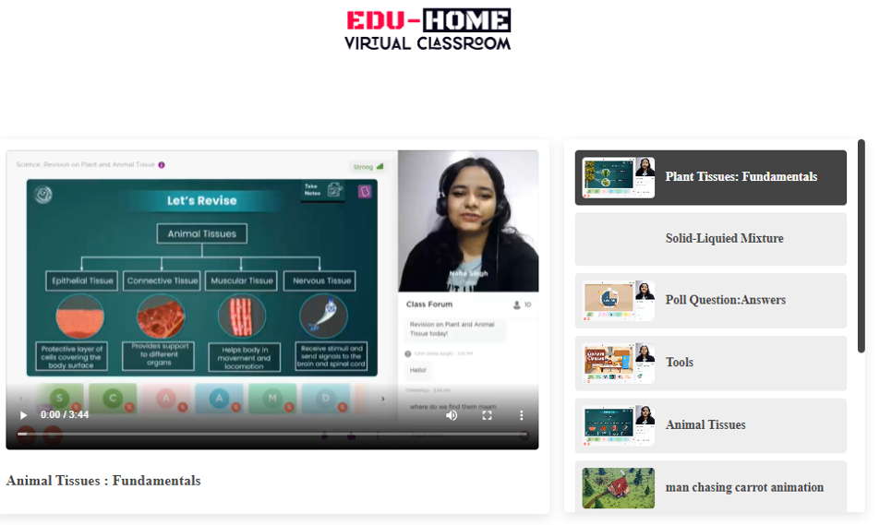
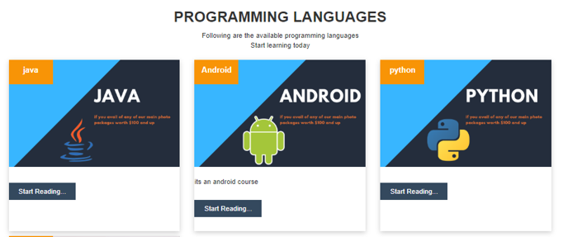
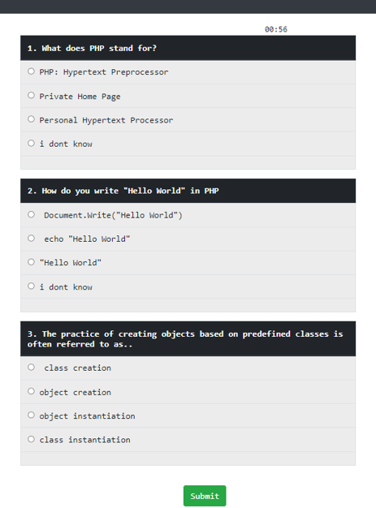
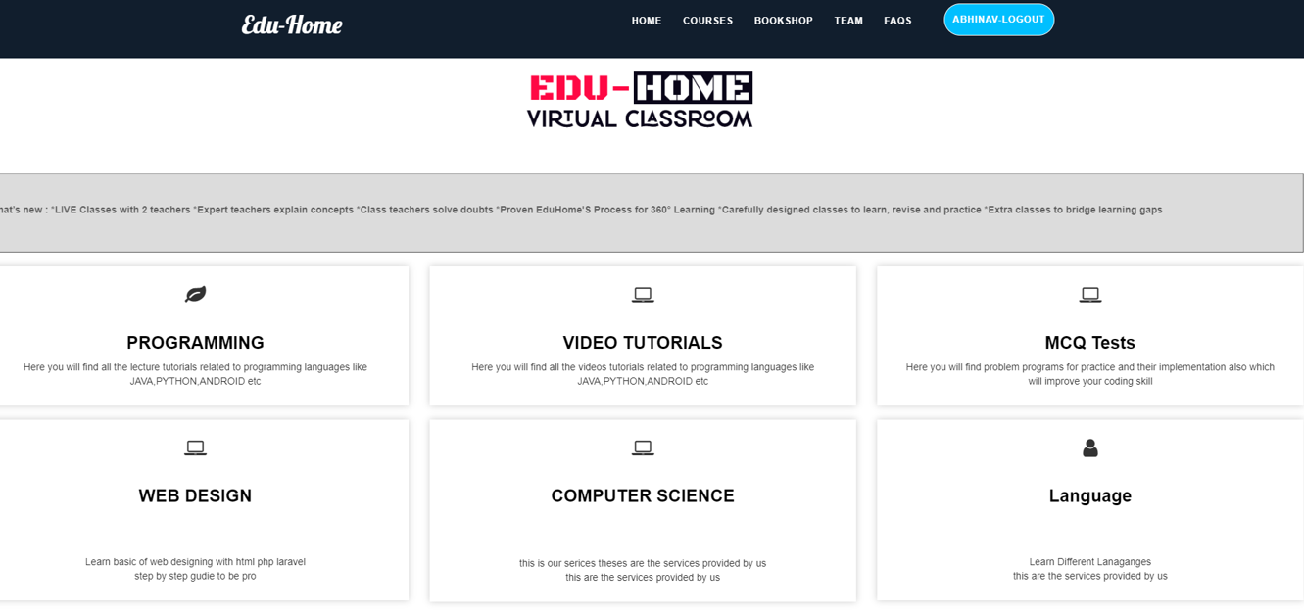
Options in User Page

Slide 6
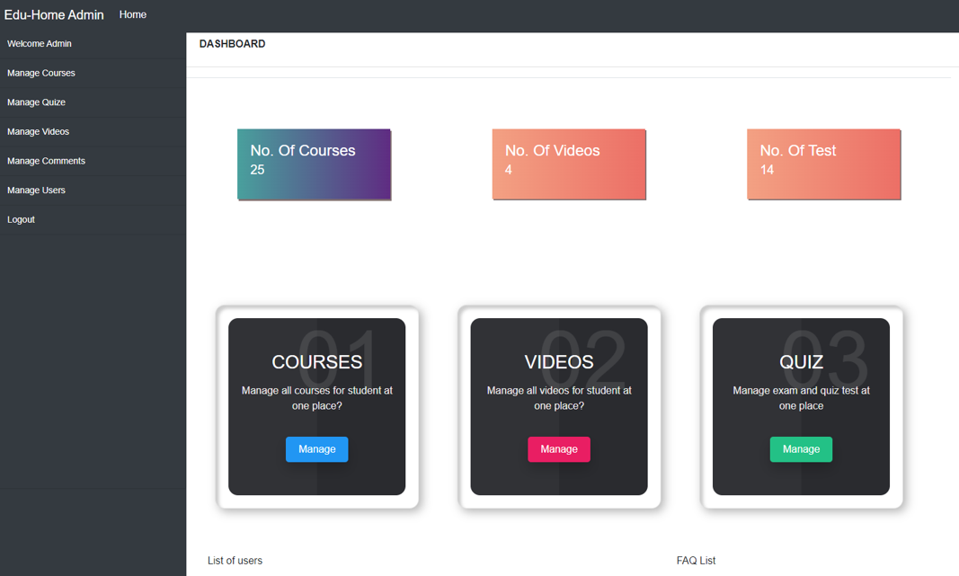
EduHome Admin Home Page

Slide 7
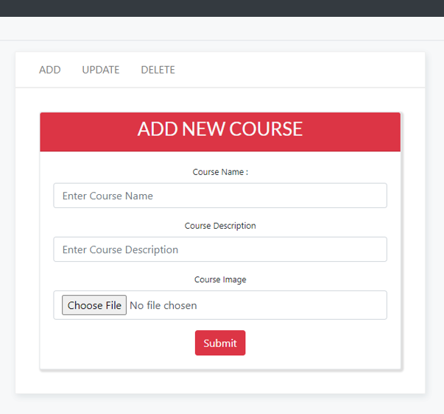
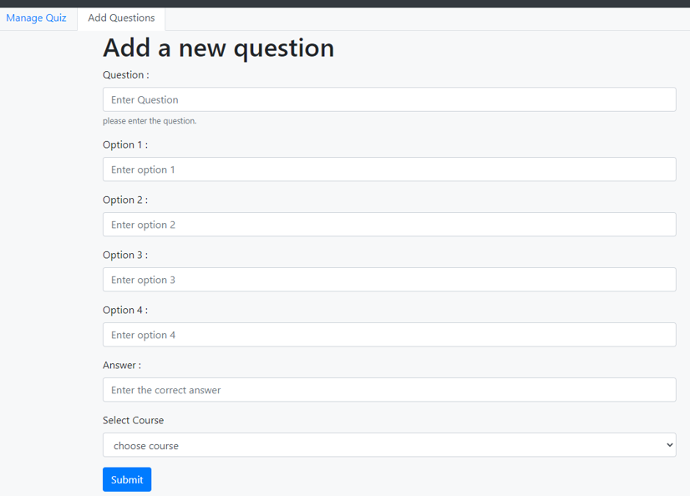
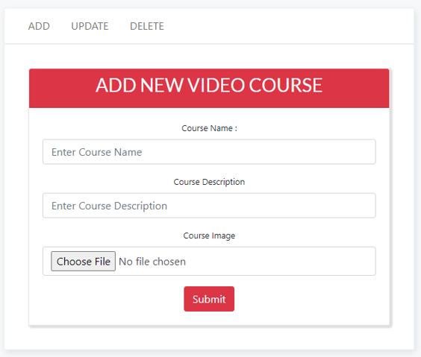
Options in Admin Page

Slide 8
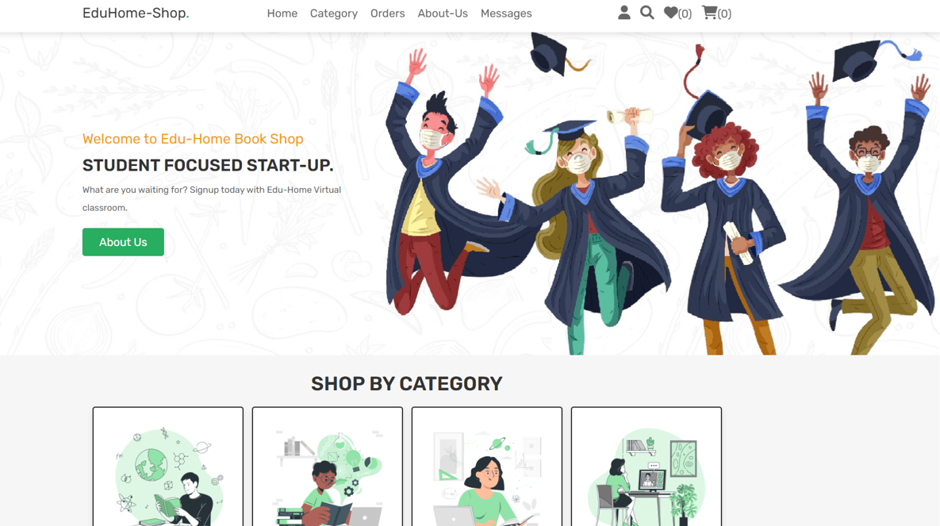
Book-Shop Home Page

Slide 9
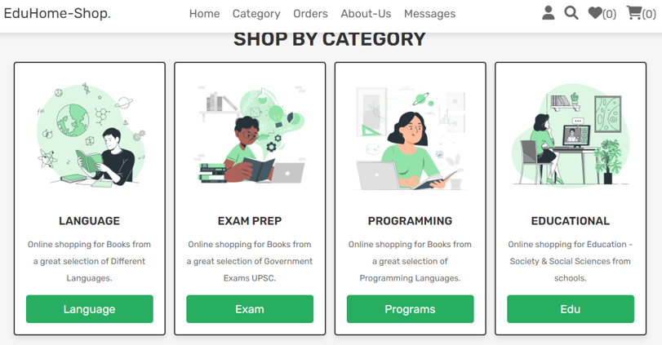
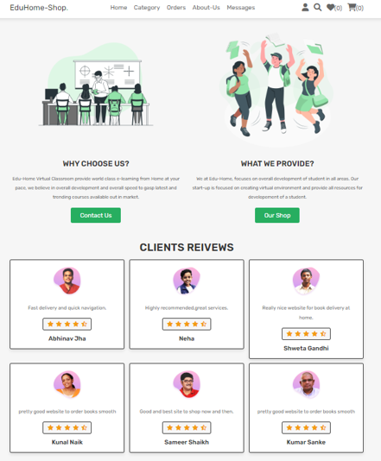
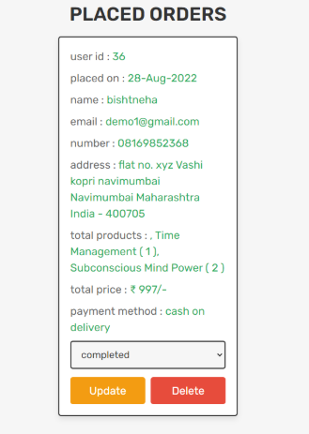
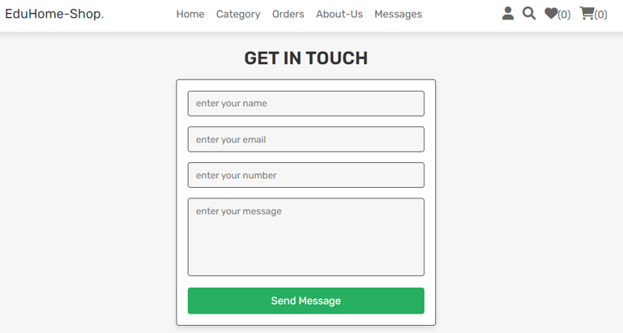
Options in Users Page

Slide 10
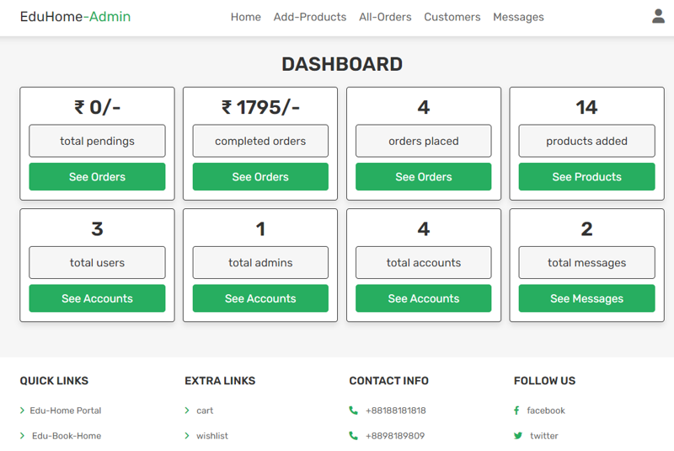
Book-Shop Admin Home Page

Slide 11
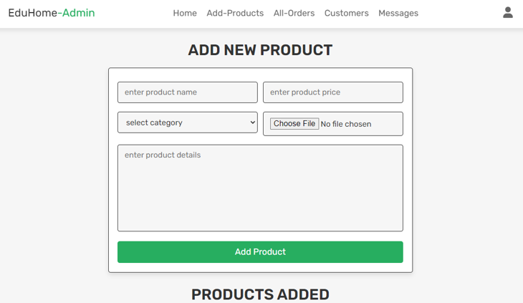
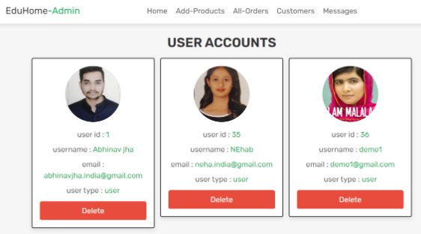
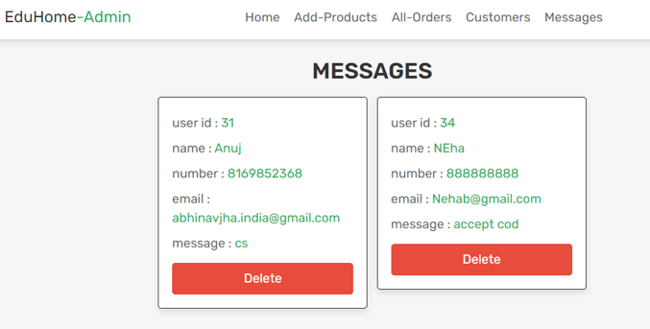
Options in Admin Page

Slide 12
Thank You!

